Slide 1
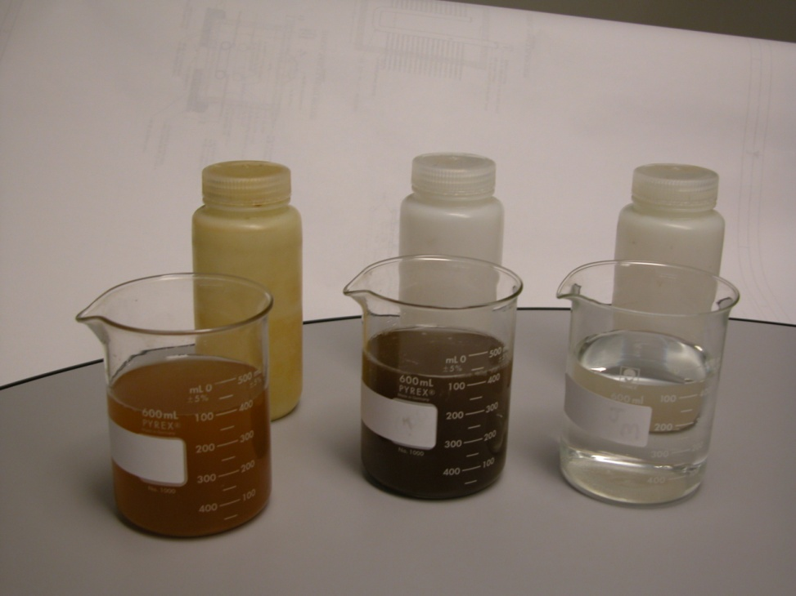
Home - About GSS - Services - Resources - Contact Us
Ground Source Solutions
Founded in 2003, Ground Source Solutions, LLC (GSS) provides comprehensive diagnostic and maintenance services for vertical closed loop, ground coupled, geothermal heat exchangers. GSS was formed by the management of Geothermal Services, Inc. in response to the growth in large scale commercial geothermal projects and the need expressed by clients to ensure the long term performance of these systems
GSS Mission Statement:
To promote optimum performance of commercial geothermal loop systems by providing top quality inspection and maintenance services.
We will provide these services in the most highly professional and ethical manner by always treating the client’s best interest as our top priority.
Water Quality Testing

Slide 2
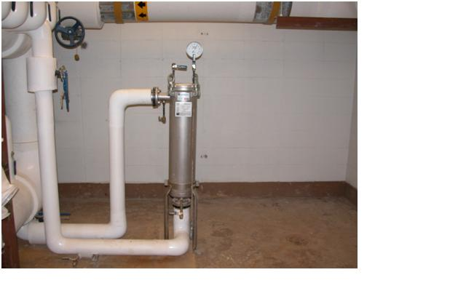
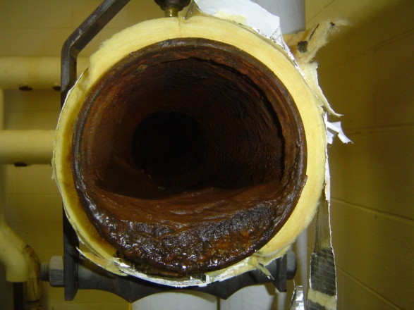
Home - About GSS - Services - Resources - Contact Us
Ground Source Solutions
Founded in 2003, Ground Source Solutions, LLC (GSS) provides comprehensive diagnostic and maintenance services for vertical closed loop, ground coupled, geothermal heat exchangers. GSS was formed by the management of Geothermal Services, Inc. in response to the growth in large scale commercial geothermal projects and the need expressed by clients to ensure the long term performance of these systems
GSS Mission Statement:
To promote optimum performance of commercial geothermal loop systems by providing top quality inspection and maintenance services.
We will provide these services in the most highly professional and ethical manner by always treating the client’s best interest as our top priority.
System Fluid Filtration

Slide 3
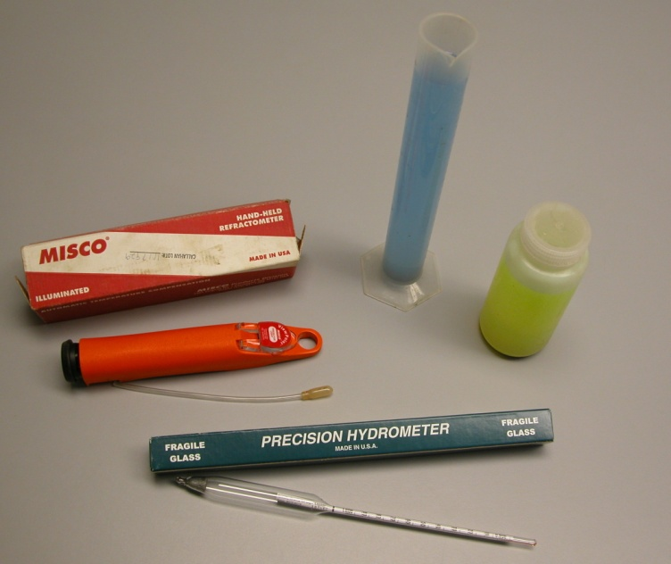
Home - About GSS - Services - Resources - Contact Us
Ground Source Solutions
Founded in 2003, Ground Source Solutions, LLC (GSS) provides comprehensive diagnostic and maintenance services for vertical closed loop, ground coupled, geothermal heat exchangers. GSS was formed by the management of Geothermal Services, Inc. in response to the growth in large scale commercial geothermal projects and the need expressed by clients to ensure the long term performance of these systems
GSS Mission Statement:
To promote optimum performance of commercial geothermal loop systems by providing top quality inspection and maintenance services.
We will provide these services in the most highly professional and ethical manner by always treating the client’s best interest as our top priority.
Antifreeze Testing

Slide 4
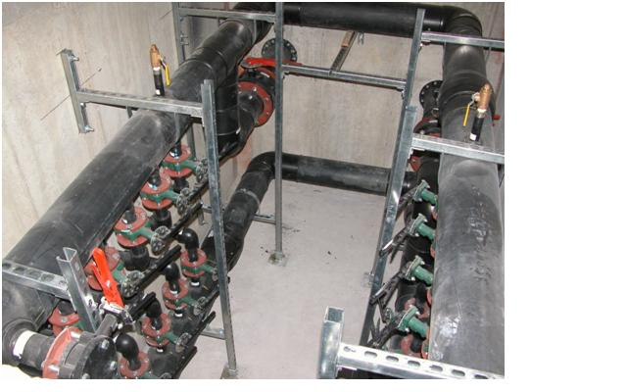
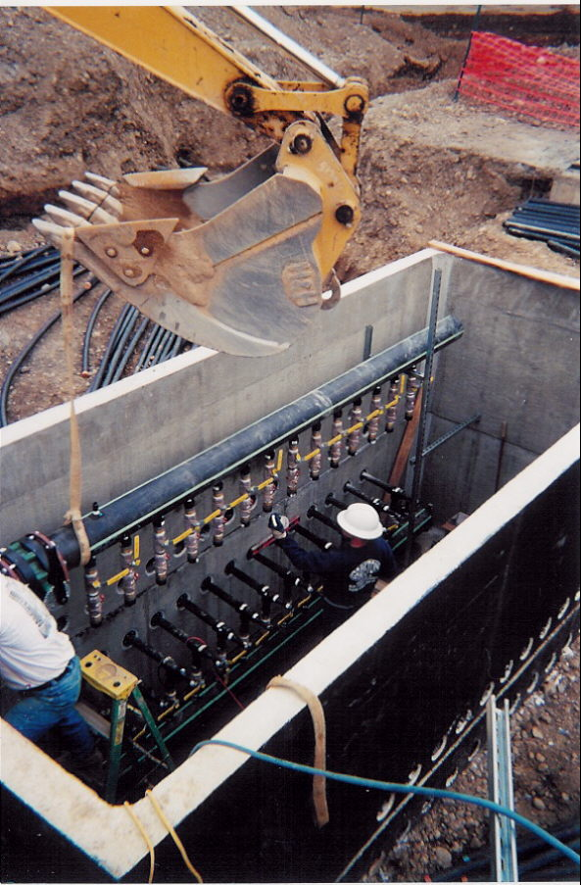
Home - About GSS - Services - Resources - Contact Us
Ground Source Solutions
Founded in 2003, Ground Source Solutions, LLC (GSS) provides comprehensive diagnostic and maintenance services for vertical closed loop, ground coupled, geothermal heat exchangers. GSS was formed by the management of Geothermal Services, Inc. in response to the growth in large scale commercial geothermal projects and the need expressed by clients to ensure the long term performance of these systems
GSS Mission Statement:
To promote optimum performance of commercial geothermal loop systems by providing top quality inspection and maintenance services.
We will provide these services in the most highly professional and ethical manner by always treating the client’s best interest as our top priority.
Manifold / Vault Inspections

Slide 5
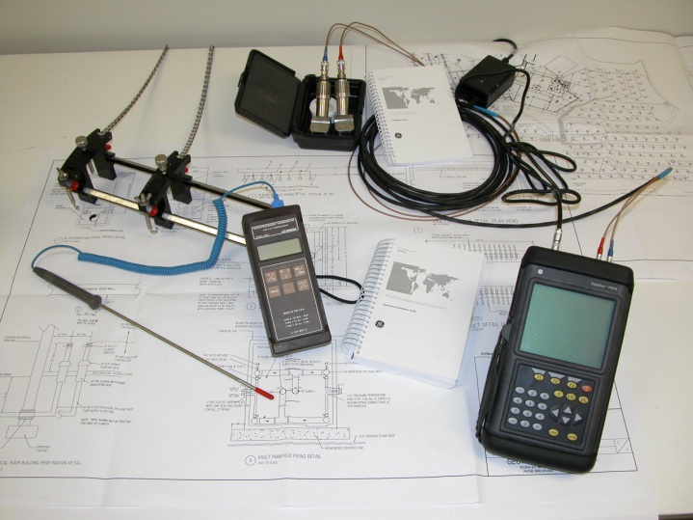
Home - About GSS - Services - Resources - Contact Us
Ground Source Solutions
Founded in 2003, Ground Source Solutions, LLC (GSS) provides comprehensive diagnostic and maintenance services for vertical closed loop, ground coupled, geothermal heat exchangers. GSS was formed by the management of Geothermal Services, Inc. in response to the growth in large scale commercial geothermal projects and the need expressed by clients to ensure the long term performance of these systems
GSS Mission Statement:
To promote optimum performance of commercial geothermal loop systems by providing top quality inspection and maintenance services.
We will provide these services in the most highly professional and ethical manner by always treating the client’s best interest as our top priority.
System Pressure & Flow Testing

